Slide 1
Communications Strategies for Vaccine Confidence:
How to Tell Your Story
WEEK 2
October 21, 2021
Notes:
Hello and welcome to Week 2 of NNCC’s Communication Strategies for Vaccine Confidence Learning Collaborative!

Slide 2
The National Nurse-Led Care Consortium (NNCC) is a non-profit membership organization that supports nurse-led care and nurses at the front lines of care.
NNCC supports comprehensive, community-based primary care and public health nursing through policy and advocacy, program development and management, technical assistance and support, and direct, nurse-led healthcare services.
Notes:
The National Nurse-Led Care Consortium is a nonprofit member-supported organization working to strengthen community health through quality, compassionate, and collaborative nurse-led care.
NNCC represents the intersection of nurse-led primary care and public health.
Our mission is to advance nurse-led health care through policy, consultation, and programs to reduce health disparities and meet people’s primary care and wellness needs.
NNCC is an affiliate of the Public Health Management Corporation.

Slide 3
COVID Vaccine Project Goals
Empower nurses with necessary information to engage care teams and communities about COVID-19 vaccines.
Provide learning opportunities to share up-to-date guidance, support peer engagement among nursing colleagues, and strengthen the nursing role.
Amplify the nursing voice by featuring nurse champions through our podcast and other media outlets.
Notes:
NNCC is partnering with the Centers for Disease Control and Prevention (CDC) to build COVID-19 vaccine confidence among nurses and the communities they serve.
Through this project, we aim to:
Empower nurses with the necessary information to engage with care teams and communities about COVID-19 vaccines;
Provide learning opportunities to share up-to-date guidance and support peer engagement among nursing colleagues; and
Amplify the nursing voice by featuring everyday nurse champions through our podcast and other media.
Please visit nurseledcare.org to learn more.

Slide 4
AGENDA
Check-In (5 minutes)
Didactic Presentation (20 minutes)
Break Out Activity (10 minutes)
Report Out (5 minutes)
Discussion/Questions (10 minutes)
Close & Debrief (10 minutes)
NNCC VACCINE CONFIDENCE TRAINING

Slide 5
LEARNING OBJECTIVES
Understand the power of personal storytelling for public health communications.
Identify steps to construct a meaningful narrative.
Learn strategies for sharing your story for the benefit of others.
NNCC VACCINE CONFIDENCE TRAINING

Slide 6
PRINCIPLES OF STORYTELLING
NNCC VACCINE CONFIDENCE TRAINING

Slide 7
STORYTELLING CHANNELS
In-person: When sharing your story in person, consider your audience and tailor your story to appeal to their unique questions and perspectives. Allow for a more conversational tone than you would in writing.
On social media: Social media gives you an opportunity to expand the reach of your story using different mediums (written word, images, video, etc.). Remember that your story might be shared with others who lack the full context, so try to make your post all-inclusive and easily accessible.
In writing: Writing your story (for an op-ed or similar) gives you a chance to say more than you might on social media. Remember that here you won’t be able to engage in a dialogue so your story should be comprehensive and self-contained.
In video: Video is a great way to tell your story. In this format you can let your personality shine through to build a deeper connection with viewers.
NNCC VACCINE CONFIDENCE TRAINING
Notes:
You can tell your story in a number of ways - all of which can help educate and impact your community. When thinking through how to tell your story and what elements to include, consider your platform and your audience.
In-person: tailor your story to appeal to their unique questions and perspectives. Allow for a more conversational tone than you would in writing.
On social media: Social media gives you an opportunity to expand the reach of your story using different mediums (written word, images, video, etc.). Remember that your story might be shared with others who lack the full context, so try to make your post all-inclusive and easily accessible.
In writing: Writing your story (for an op-ed or similar) gives you a chance to say more than you might on social media.
In video: Video is a great way to tell your story. In this format you can let your personality shine through to build a deeper connection with viewers.

Slide 8
BUILDING YOUR STORY
Here are a few key elements to crafting and telling your story:
Be Vulnerable: Stories should include facts, but ultimately, your story should be personal. Don’t be afraid to share your own emotions and how they impacted your decisions.
Build Connection: The best stories aren’t only about the teller; they’re relatable. Craft your story in a way that helps listeners connect to you as an individual.
Reinforce Trust: Nurses are one of the most trusted professions. By sharing honest, truthful stories you are helping to reinforce trust in your community. Avoid exaggeration and deliver your story in a clear, accessible way.
NNCC VACCINE CONFIDENCE TRAINING
Notes:
Storytelling is a powerful way to share information, help people understand the world around them, and spur communities into action. By sharing your personal COVID-19 vaccine story, you can help build vaccine confidence in your community.

Slide 9
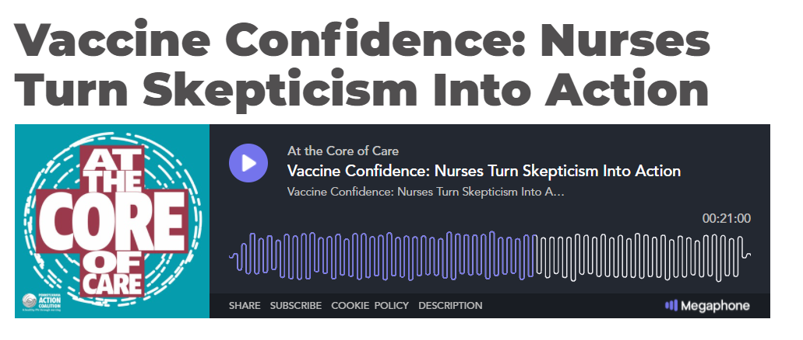
BEING YOUR AUTHENTIC SELF
https://www.paactioncoalition.org/about/podcast/item/626-vaccine-confidence-nurses-turn-skepticism-into-action.html
NNCC VACCINE CONFIDENCE TRAINING
Notes:
Start at 21:00 – 22:25
Here we see an example of sharing your story through a podcast.
NNCC’s At the Core of Care Podcast did a series on vaccine confidence earlier this year. Monica Harmon, who is also my co-facilitator, is featured in this clip. Monica talks about her approach to discussing vaccines.
https://www.paactioncoalition.org/about/podcast/item/626-vaccine-confidence-nurses-turn-skepticism-into-action.html

Slide 10
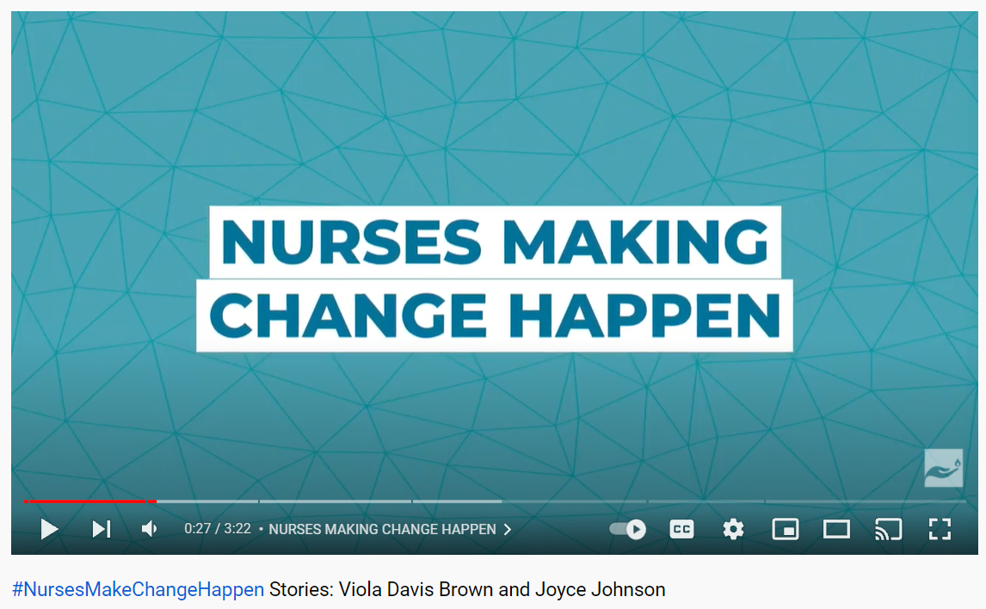
Example of Sharing Your Story through Video
NNCC VACCINE CONFIDENCE TRAINING
https://www.youtube.com/watch?v=DpVbLrd0ZgM&t=1s
Notes:
In this video, we hear from Nurse Joyce Johnson.
Joyce is the Clinical Director of Outpatient Services at Stepworks Recovery Centers in Kentucky. Let’s listen in!
https://www.youtube.com/watch?v=DpVbLrd0ZgM&t=1s

Slide 11
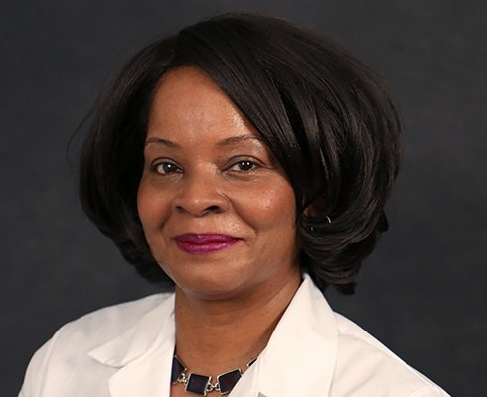
Example of Sharing Your Story in Writing
“I know that vaccines save lives,” Dr. Crump said. “So, I want to do the best that I can and offer the most up-to-date scientific information to patients.”
- Evelyn Crump PhD, WHNP-BC, FNP-BC
NNCC VACCINE CONFIDENCE TRAINING
Full article linked here
Notes:
In Dover, Delaware, family nurse practitioner Evelyn Crump was interviewed by Bay to Bay News.
Dr. Crump is dually credentialed as a Women's Health and Family Nurse Practitioner.
She says, “I know that vaccines save lives. So, I want to do the best that I can and offer the most up-to-date scientific information to patients.”

Slide 12
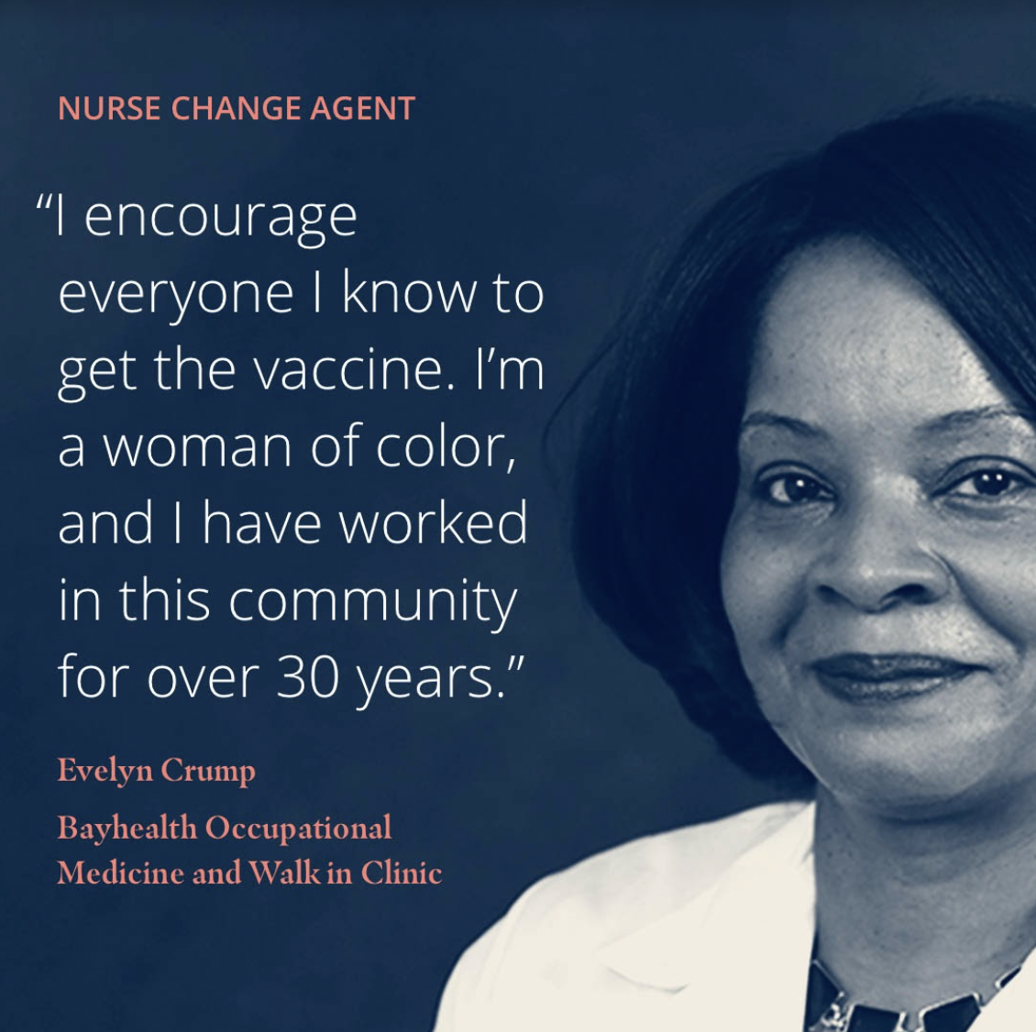
Example of Sharing via Social Media Image
NNCC VACCINE CONFIDENCE TRAINING
Notes:
Here is Dr. Evelyn Crump again, sharing her story via social media.
By sharing a little bit about herself and her long-standing commitment to working in this community, Evelyn is able to make a strong connection with families and be a nurse change agent!

Slide 13
HOW TO CONSTRUCT A MEANINGFUL NARRATIVE
NNCC VACCINE CONFIDENCE TRAINING

Slide 14
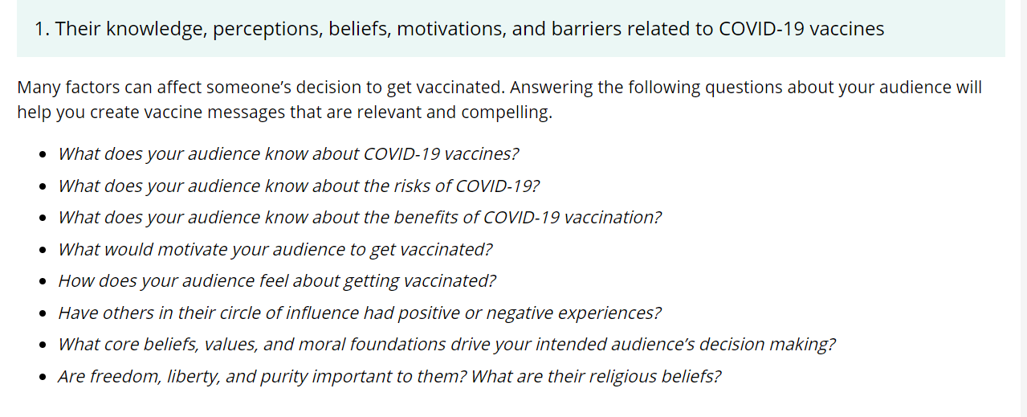
UNDERSTAND YOUR AUDIENCE
https://www.cdc.gov/vaccines/covid-19/hcp/tailoring-information.html
NNCC VACCINE CONFIDENCE TRAINING
Notes:
To craft a meaningful narrative, one must consider who the narrative is for. How can we best connect with our audience?
The CDC offers guidance for how to tailor COVID-19 information for different communities.
To understand your audience, one must consider their knowledge, beliefs, motivations, and barriers related to the COVID-19 vaccines.
By answering some of the example questions here, you can create messages that well resonate with your audience.
What does your audience know about the COVID-19 vaccines?
What do they know about the risks?
What would motivate them to get vaccinated?
What core beliefs or values drive your audience’s decision making?

Slide 15
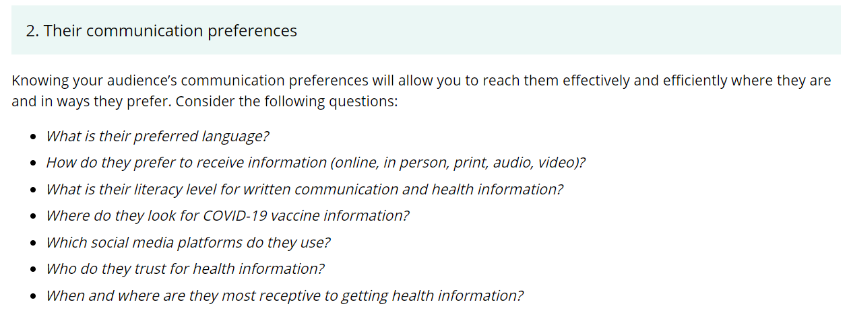
UNDERSTAND YOUR AUDIENCE
https://www.cdc.gov/vaccines/covid-19/hcp/tailoring-information.html
NNCC VACCINE CONFIDENCE TRAINING
Notes:
Another element of understanding your audience is understanding their communication preferences.
What is their preferred language?
What is their literacy level for written communication and health information?
Where do they look for COVID-19 vaccine information?
Who do they trust for health information?

Slide 16
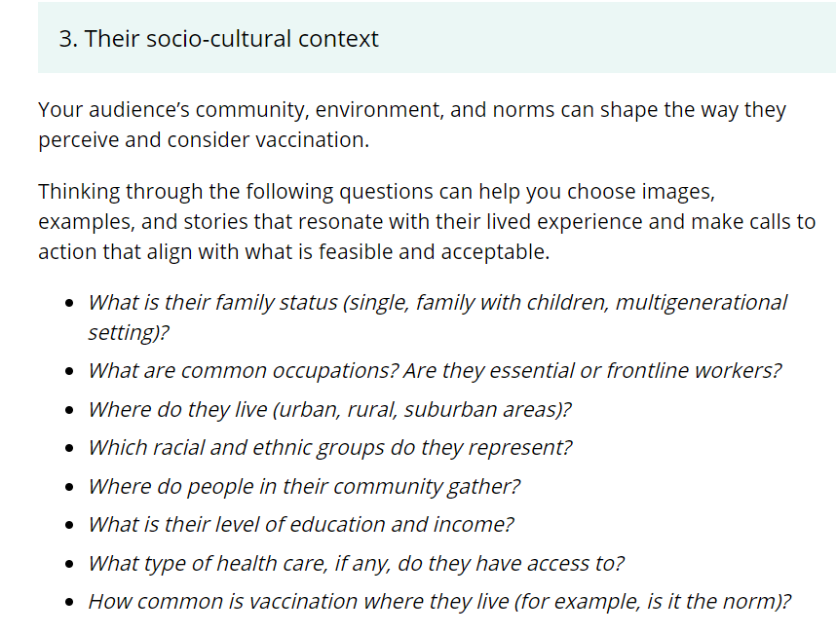
UNDERSTAND YOUR AUDIENCE
NNCC VACCINE CONFIDENCE TRAINING
https://www.cdc.gov/vaccines/covid-19/hcp/tailoring-information.html
Notes:
And lastly, you will want to understand your audience’s socio-cultural context –the community, environment and cultural norms that can shape viewpoints of vaccination.
When creating messaging and selecting images for materials, consider:
What are common occupations among this audience that would be important to represent?
Where do they live (urban, rural, suburban areas?)
Where do people in their community gather?
These are just a few examples of where to begin in making better connections with your audience.

Slide 17
CREATE TAILORED MESSAGES
Focus on your audience’s “why” or motivations for getting vaccinated
Incorporate values that resonate with your audience.
Invite people to have conversations with their healthcare professionals.
Provide details on how to get vaccinated.
NNCC VACCINE CONFIDENCE TRAINING
https://www.cdc.gov/vaccines/covid-19/hcp/tailoring-information.html
Notes:
Once we have a better understanding of our audience, it’s now time to create tailored messages and materials.
Focus on your audience’s “why” or motivations for getting vaccinated - Tap into emotional triggers. Everyone who chooses to get vaccinated does it for a reason—to protect themselves and their family or to get back to activities like seeing friends, resuming work, or returning to in-person school. The reasons that drive someone’s decision to get vaccinated will always be those that are most compelling to them personally.
Incorporate values that resonate with your audience.
Invite people to have conversations with their healthcare professionals. – Encourage people to “talk with their primary care provider” instead of telling them to get vaccinated. This is a nonthreatening way to help your audience learn more about COVID-19 vaccination from someone they know and trust.
Provide details on how to get vaccinated. - Include simple, doable, and time-bound calls to action, such as “Go to Vaccines.gov to find a vaccination location today.”

Slide 18
BREAK OUT GROUPS
Understanding Your Audience
NNCC VACCINE CONFIDENCE TRAINING

Slide 19
SCENARIO 1
Vaccine hesitancy in pregnancy
Emma is currently 30 weeks pregnant with her first child. She is unvaccinated and wants to wait and see more data before getting vaccinated. She recently read on Facebook that the COVID-19 vaccine would hurt her baby and has now decided she won’t get vaccinated . . .
SCENARIO 2
Vaccine hesitant nurse
Steve is a nurse who had COVID-19 twice in the last year and a half. His employer, the local hospital, is mandating vaccines for all staff. Steve doesn’t believe he should have to get vaccinated and has stated multiple times that he has full immunity. . .
NNCC VACCINE CONFIDENCE TRAINING

Slide 20
REPORT OUT
NNCC VACCINE CONFIDENCE TRAINING

Slide 21
REPORT OUT
Which elements of understanding your audience did you find most challenging?
1. Their knowledge, perceptions, beliefs, motivations, and barriers related to COVID-19 vaccines
2. Their communication preferences
3. Their socio-cultural context
NNCC VACCINE CONFIDENCE TRAINING

Slide 22
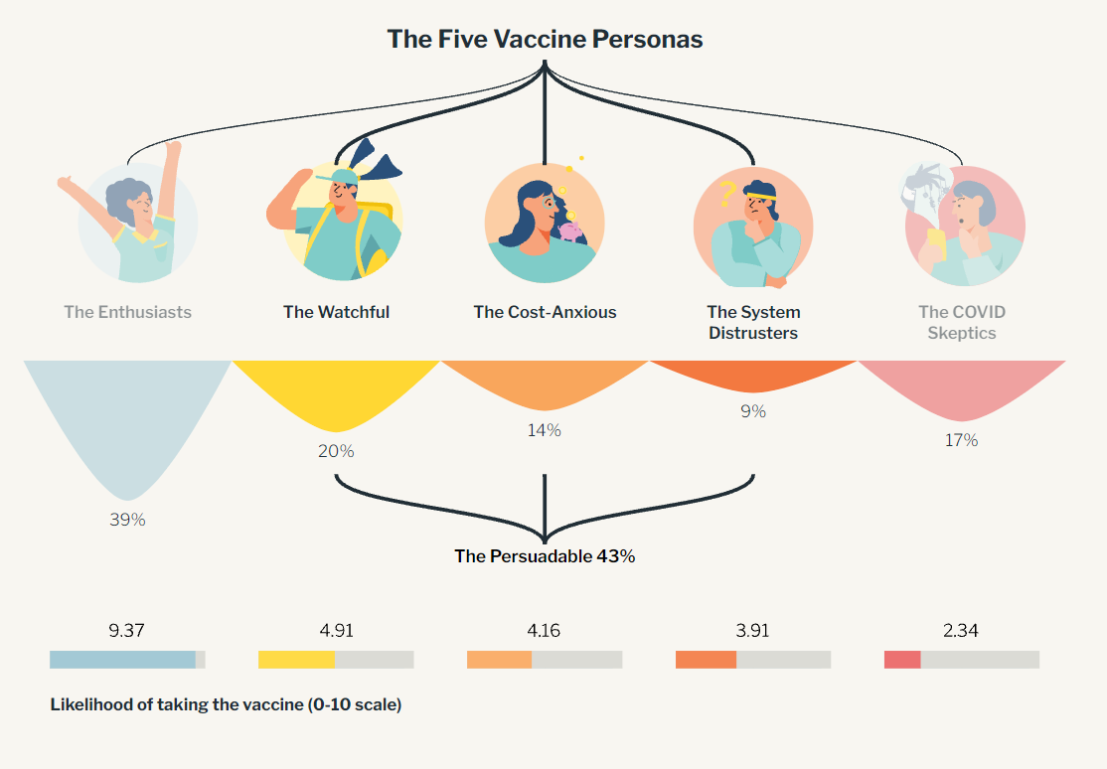
FIVE VACCINE PERSONAS IN THE U.S.
NNCC VACCINE CONFIDENCE TRAINING
https://surgoventures.org/vaccine-persona-explainer
Notes:
Surgo Ventures, a nonprofit organization with headquarters in Washington, DC focused on solving health and social problems, created an interactive tool that helps people craft messaging based on the vaccine personas.
This takes a psychobehavioral approach in understanding people’s behaviors to make progress on vaccine conversations.
Their survey found that 39% of Americans are highly likely to get the vaccine, with the remaining 60% falling into four less likely segments, with a variety of concerns and barriers shaping their likelihood.
On one end of the vaccine likelihood spectrum we have The Enthusiasts, who are ready and willing to get the vaccine, and on the other end we have The COVID Skeptics who are guided by misinformation and unlikely to get vaccinated.
Each of these personas express different likelihood of getting vaccinated on a scale up to 10.
Three of these segments (labeled "The Persuadable") can likely be convinced to take the vaccine, due to barriers they have that we believe can be overcome with the right interventions.

Slide 23
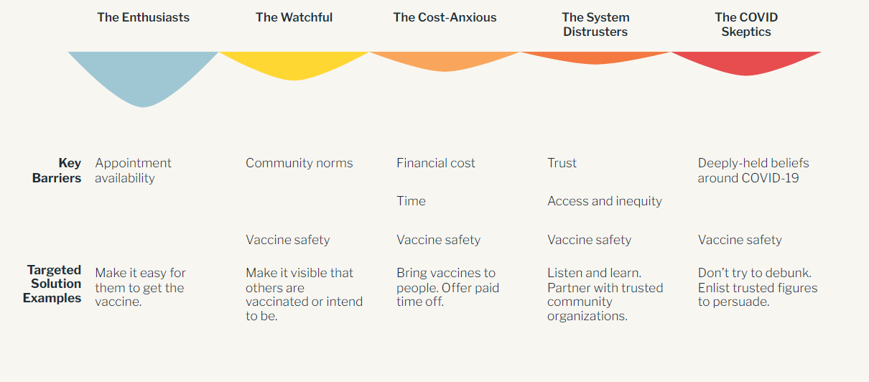
FIVE VACCINE PERSONAS IN THE U.S.
NNCC VACCINE CONFIDENCE TRAINING
https://surgoventures.org/vaccine-persona-explainer
Notes:
This next slide shows us the common barriers experienced by these 5 personas.
They vary between things like appointment availability, community norms, trust, and so on.
What’s interesting is perception of “vaccine safety” is a barrier for 4 of the 5 personas>> so it’s really important to discuss vaccine safety in your messaging.
For each of these personas, we also see targeted solutions, such as using trusted figures with COVID Skeptics and offering paid time off for the Cost-Anxious.

Slide 24
IDENTIFY A COVID-19 VACCINE PERSONA
https://vaccinequiz.precisionforcovid.org/
NNCC VACCINE CONFIDENCE TRAINING
Notes:
Let’s test out the tool together!

Slide 25
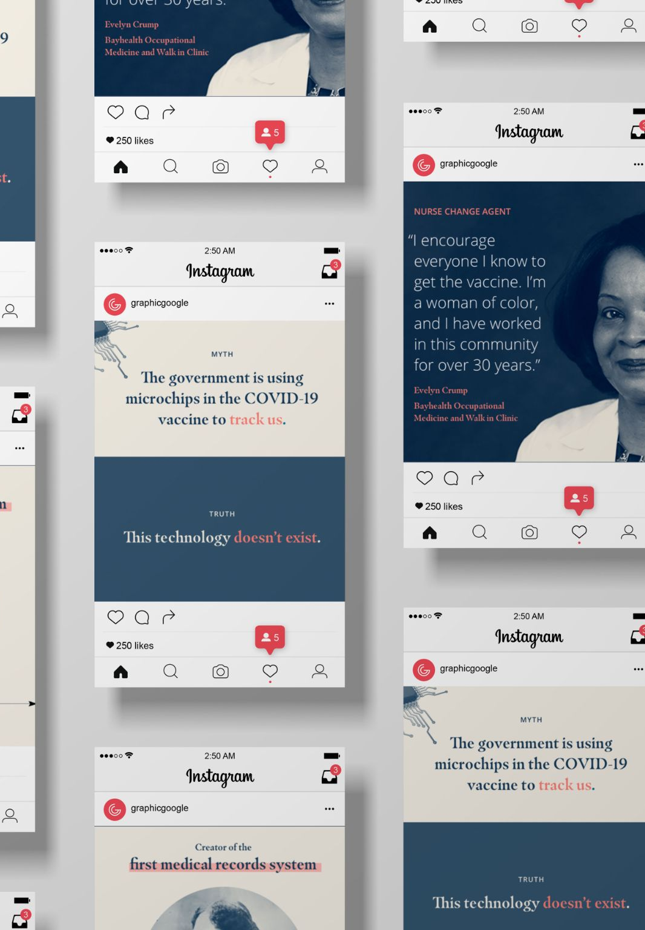
SHARING YOUR STORY
NNCC VACCINE CONFIDENCE TRAINING

Slide 26
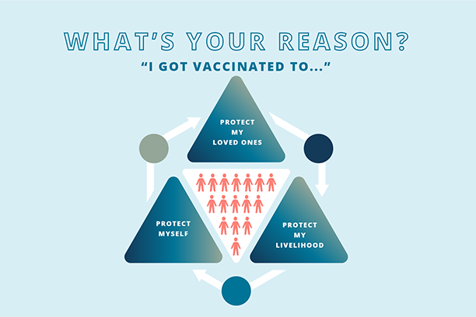
TOOLS TO HELP YOU SHARE YOUR STORY
Our Nurses Toolkit includes a number of tools that can help you craft and share your story:
Social Media Pack The templates and guide in this pack will help you to share your story and information with others, specifically on social media.
NNCC VACCINE CONFIDENCE TRAINING
Notes:
Our Nurses Toolkit includes a number of tools that can help you craft and share your story:
One of these is our social media pack.
The social media pack includes ready-to-go images and templates to help you share your story via social media platforms.

Slide 27
TOOLS TO HELP YOU SHARE YOUR STORY
Guide to Sharing Your Story This downloadable PDF will guide you through the creation of your story - complete with examples and a how-to guide.
NNCC VACCINE CONFIDENCE TRAINING
Notes:
We also have created a Guide to Sharing Your Story.
This guide is a template to craft your own vaccine story.

Slide 28
QUESTIONS?
NNCC VACCINE CONFIDENCE TRAINING

Slide 29
ADDITIONAL RESOURCES
SHARE YOUR STORY A How-to Guide for Digital Storytelling (SAMHSA)
Vaccine Persona Quiz – Sugo Ventures
Build Vaccine Confidence By Sharing Vaccine Stories and Testimonials (NYC Health Department)
NNCC VACCINE CONFIDENCE TRAINING
Notes:
Here are some additional great resources to check out.
SAMHSA’s Share Your Story guide to digital storytelling – This guide by the Substance Abuse and Mental Health Services Administration is designed to help individuals living with mental and substance use disorders share personal stories of recovery using a digital format. However, the guide can be helpful for communicating about other health topics as well—such as COVID-19 and the vaccine. It also includes templates for organizations such as consent forms for people sharing their story through videos, and more.
Vaccine Persona Quiz by Surgo Ventures – the interactive tool we reviewed earlier this hour.
Build Vaccine Confidence By Sharing Vaccine Stories and Testimonials – The NYC Health Department recently came out with this helpful 2-page guide on how to share your vaccine story and best practices for sharing others’ vaccine stories.

Slide 30
Please submit questions through this Google Form. We will address them during the live sessions.
Notes:
Please submit any questions you have using this Google Form. This link will also be found in your welcome email from NNCC.
Google Form: https://forms.gle/eKQCmXPx1McLsVBL6
We will address questions during the live session next week.

Slide 31
Notes:
Thank you for tuning in to this session. Please complete the post-session quiz to receive CE credits. The link to the quiz will be available in the Google Drive Folder in the next couple days. We will also share the link by email when available.
We hope to see you back next week for a session on Sharing Information Through Social Media, led by NNCC’s Communications team member, Sierra Little.

